Slide 1


Department of Artificial Intelligence & Data Science
Main Presentation
Under
Industrial Training Presentation(7AID7-30)
Session-2024-25(Odd)
Presented by
Naitik Pareek
PIET21AD030
E
Presented to
Dr. Ajay Maurya
Mr. Vikas Kumar

Slide 2
Industrial Training - MAIN Presentation
POORNIMA INSTITUTE OF ENGINEERING & TECHNOLOGY, JAIPUR
Department of Artificial Intelligence and Data Science
INDUSTRIAL TRAINING PRESENTATION
ON
Company growth analysis
SESSION 2024-25

Slide 3
Company growth analysis
OBJECTIVE
This analysis aims to identify trends, strengths, and areas for improvement in the company’s financial performance. Through an interactive Power BI dashboard, it will provide insights into savings, expenses, income, and targets, guiding strategic decisions to sustain growth and identify opportunities for future improvement.

Slide 4
Project Technology
Power BI:
Power BI will be used as the primary tool for creating the interactive dashboard. It will enable the visualization of key metrics such as savings, expenses, income targets, and a yearly calendar, providing real-time insights into company growth.
Data Integration and Transformation:
Power BI's data modeling features will be employed to integrate data from various sources, perform transformations, and build relationships between datasets to provide a unified view of the company’s financial metrics.
Visualization and Reporting:
The project will utilize Power BI's advanced visualization features to create dynamic charts, graphs, and dashboards, ensuring that data is presented in an easy-to-understand format, helping stakeholders track performance and make data-driven decisions.

Slide 5
Project Modules and Libraries
Data Import and Transformation:
Power Query: Imports data from various sources and transforms it for
analysis.
Data Modeling:
DAX (Data Analysis Expressions): Creates calculated columns and measures
for enhanced analytics.
Visualizations:
Power BI Visualizations Library: Uses built-in and custom visuals for data
presentation.
User Interaction:
Bookmarks and Buttons: Improves user experience by enabling navigation
and highlighting data points.
Deployment and Sharing:
Power BI Service: Publishes dashboards online for sharing and collaboration with
stakeholders.

Slide 6
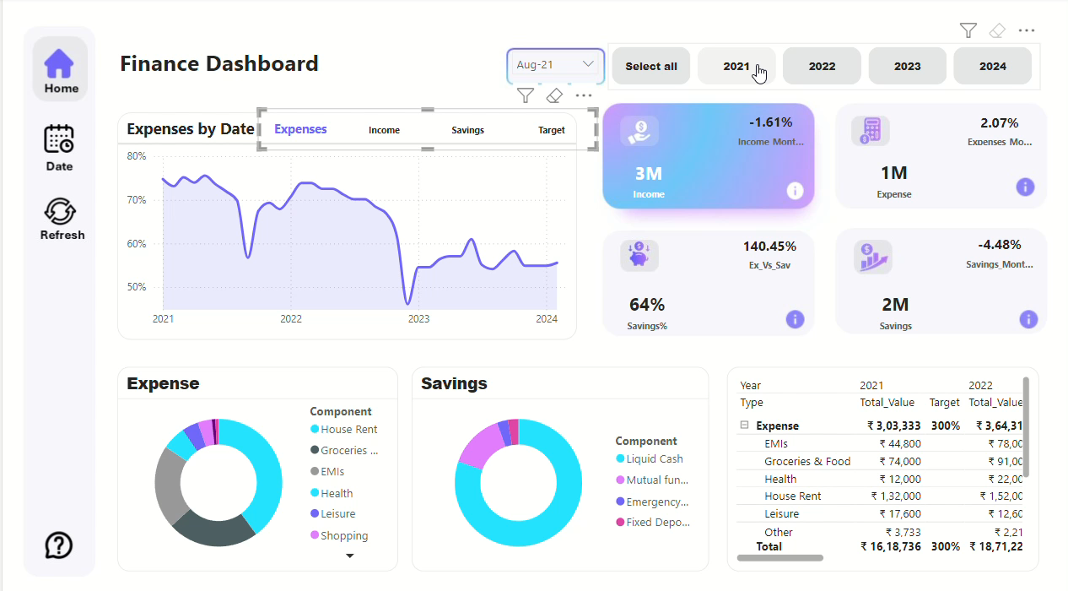
Project Demonstration

Slide 7
Project Learning Outcome
Enhanced Decision-Making: Real-time data visualizations enable quick assessment of financial performance for informed decisions.
Improved Financial Tracking: The dashboard offers a clear view of savings, expenses, and income targets, enhancing planning accuracy.
Identification of Trends: Yearly visualizations help spot income and expense trends, allowing proactive strategy adjustments.
User-Friendly Interface: The dashboard is designed for intuitive navigation, ensuring accessibility for all technical levels.
Actionable Insights: Analyzing data generates insights that guide decision-making, identifying growth opportunities and mitigating risks.

Slide 8
Conclusion
The dashboard offers a clear view of important financial data like savings, expenses, and income goals, along with a yearly calendar. This tool helps decision-makers get instant insights, making it easier to guide the company’s growth. By tracking financial health, the dashboard aids in planning for a successful future.

Slide 9
Future plans
Enhance the existing analytical framework to better address business growth challenges.
Establish a feedback loop to incorporate user suggestions for ongoing improvements.
Analyze financial data to enhance resource allocation and reduce inefficiencies.
Create cloud-based dashboards for immediate access to key financial metrics.
Identify opportunities for cost reduction to improve overall financial stability.
Use dynamic reporting tools to reflect current financial conditions and metrics.
Regularly evaluate and adjust business strategies based on data-driven insights.

Slide 10
Thanks
&
Query

